Slide 1

COS 214 Project
sudo-apt-get-marks

Slide 2

sudo-apt-get-marks members
u22497082 - Ethan Vletter
u22652974 - Carinda Smith
u23632730 - Janri du Toit
u23577674 - Ethan Wilke
u23656175 - James Neale
u23708833 - Megan Pretorius
u23590883 - Marco Paximadis

Slide 3

Introduction
In this world made up of billions of unique personalities, all with thoughts of our own, there is one thing that we all dream of nightly. Being your own communist government in a terminal-based city builder.
We at sudo-apt-get-marks recognized this longing desire. Using the software modelling techniques learnt in COS214, we were able to bring this dream to life.
Our program allows our users to create buildings, provide jobs for our citizens, supply them with power and much more.
We start this product presentation off with details about all the design patterns we used.

Slide 4
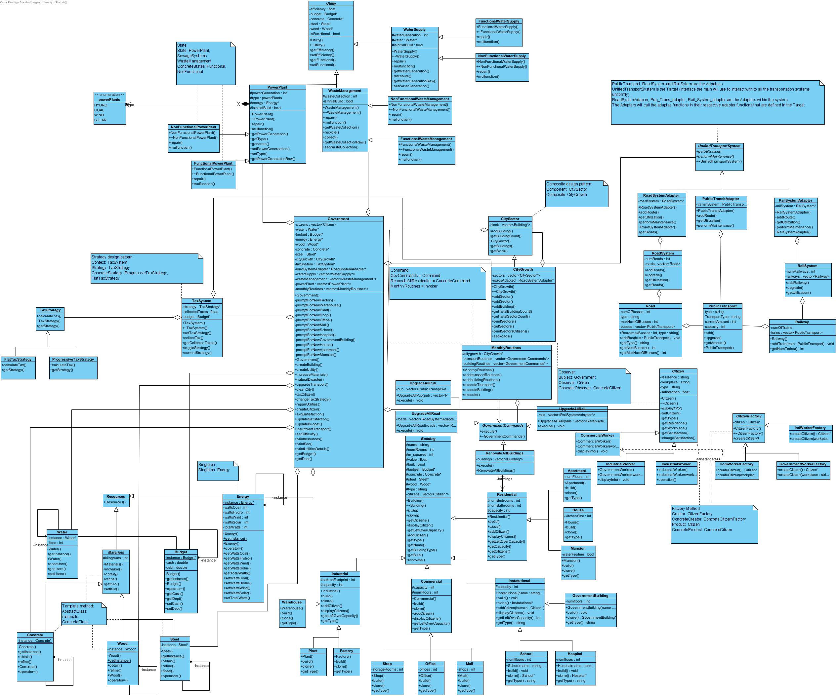
Final class diagram
List of all Design Patterns used:
Factory method
Prototype
State
Adapter
Composite
Strategy
Singleton
Template Method
Command
Observer

Slide 5

Citizens
Citizen instances add depth to the simulation by representing individual needs and reactions, allowing the Government(player) to measure and adjust based on the population’s satisfaction response to taxes, infrastructure and transportation.
A citizen can be an Industrial worker(works at factory, plant or warehouse), Government worker(works at school, hospital or government) or Commercial worker(works at an office, mall or shop).
A citizen is a resident of an apartment, house or mansion.

Slide 6
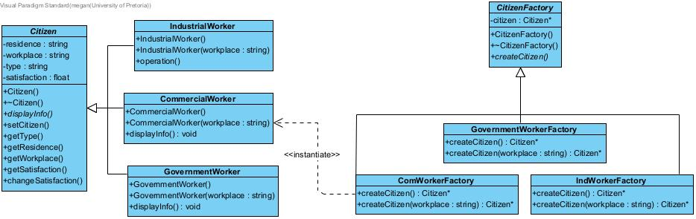
Citizens

Slide 7
Citizens
Factory Method:
Used to manage and create instances of classes with a shared interface.
This allows for flexibility and extensibility in creating different tipes of citizens without modifying the client code that uses the factory.
Product(Citizen) – abstract base class for different types of citizens
Concrete Products(CommercialWorker, IndustrialWorker and GovernmentWorker) -These classes inherit from Citizen.
Each representing a specific type of citizen.
The classes initialize residence and workplace to default values relevant to their type.
Creator(CitizenFactory) – This abstract factory class defines an interface for creating a Citizen object.
Concrete Creators(ComWorkerFactory,IndWorkerFactory,GovWorkerFactory) – These classes inherit from CitizenFactory.
Each subclass is responsible for creating instances of a specific Citizen subtype using createCitizen().
createCitizen(workplace) – creates and returns a Citizen object of the specified type with a specific workplace.

Slide 8
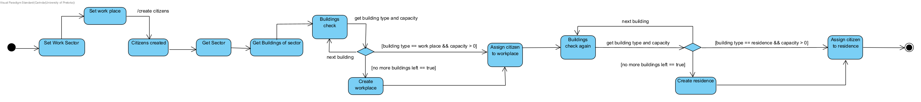
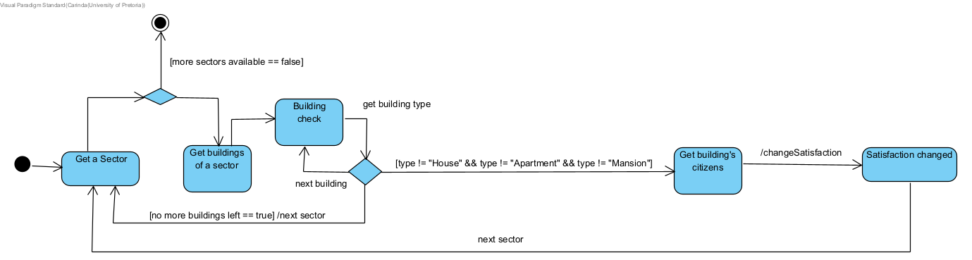
Citizens State Diagrams
Citizens Creation:
Citizens Satisfaction:

Slide 9
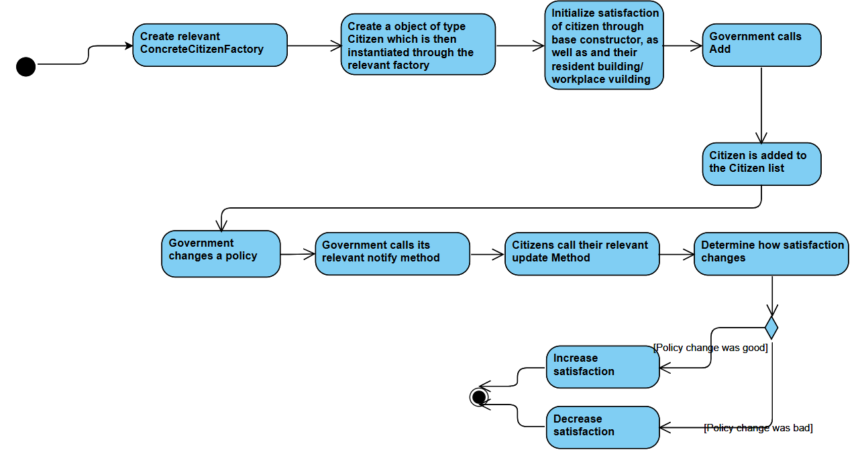
Citizens Activity Diagrams

Slide 10

Buildings
Create and manage different types of buildings.
The Building class implements the Prototype design pattern, enabling a flexible and dynamic approach to creating building types. We use four primary groups of buildings, namely Residential, Institutional, Commercial, and Industrial. Each group contains three subtypes of buildings.
Each subtype has its own unique factors, for example, resource allocation, calculation of square footage and many more. This differentiation ensures that the build function for each type of building is tailored to its specific requirements. Once an object is created, it can be easily cloned, enabling the efficient generation of similar building instances.
Furthermore, we have integration between buildings and citizens. Each building can be associated with a specific type of citizen, creating a relationship between where people live and work. For example, a Commercial Worker can be linked to a House to indicate their residence and can also be connected to either a Mall, Shop, or Office, which signify their workplace. This integration provides a comprehensive view of community dynamics, highlighting both residential and workplace (Institutional, Commercial, and Industrial) interactions.

Slide 11
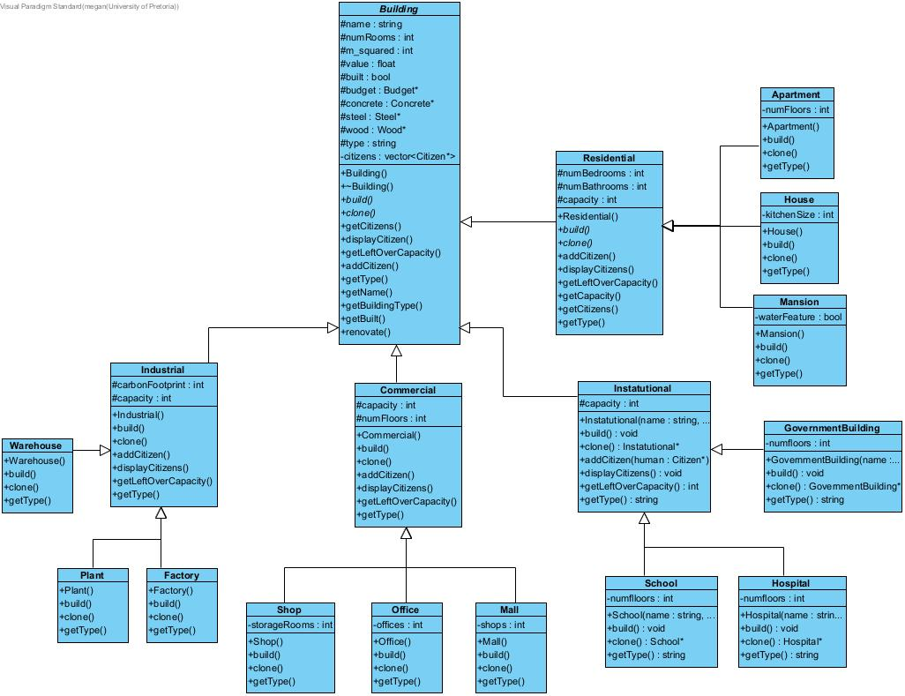
Buildings
Relationships that were created between Buildings and Citizens:
CommercialWorker: Workplace: shop/mall/office Residence: House
GovernmentWorker: Workplace: school/hospital/government Residence:Mansion
IndustrialWorker: Workplace: warehouse/plant/factory Residence: Apartment
Participants:
Prototype: Residential, Instatutional, Commercial, Industrial
ConcretePrototype : Shop, Mall, Office,Warehouse, Factory, Plant,House, Apartment, Mansion, Hospital, School, Government

Slide 12
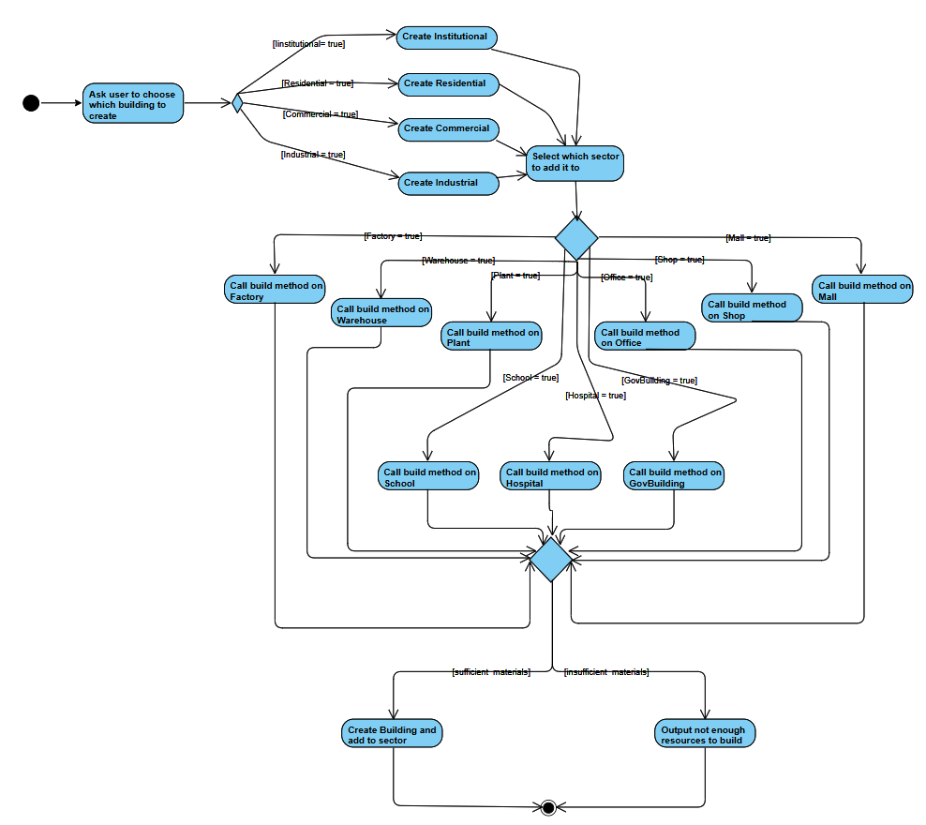
Buildings Activity Diagram

Slide 13

Utilities
Utilities allow the city to be cleaned and aid in the production of certain resources in the city. E.g. Powerplants increase the amount of energy that is produced.
Utilities implements the state design pattern. Utilities appear to change their class through the repair and malfunction functions.
A utility that has malfunctioned operates at a lower efficiency and can be repaired to operate at max efficiency again.
The government acts as the context class. Natural disasters cause utilities to malfunction. The user can choose to repair utilities when they have malfunctioned.

Slide 14
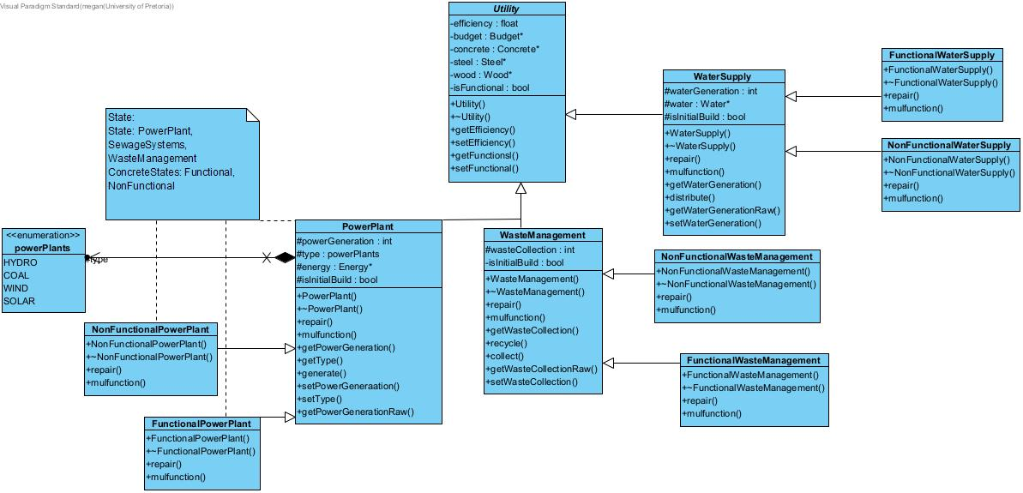
Utilities
State: PowerPlant, WasteManagement, WaterSupply
ConcreteStates: FunctionalPowerPlant, NonFunctionalPowerPlant
Context: Government

Slide 15
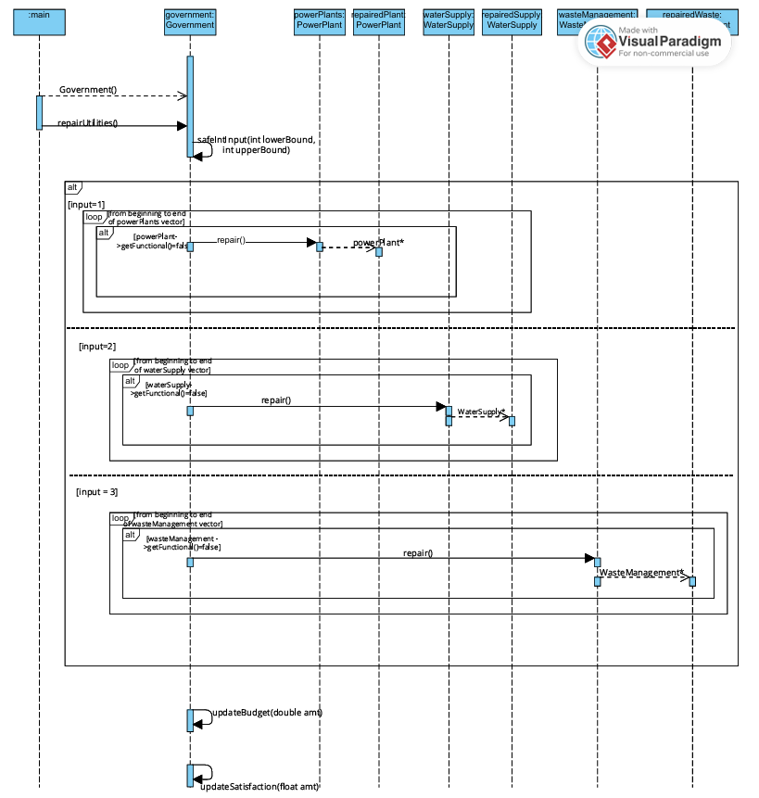
Utilities
Sequence
Diagram

Slide 16
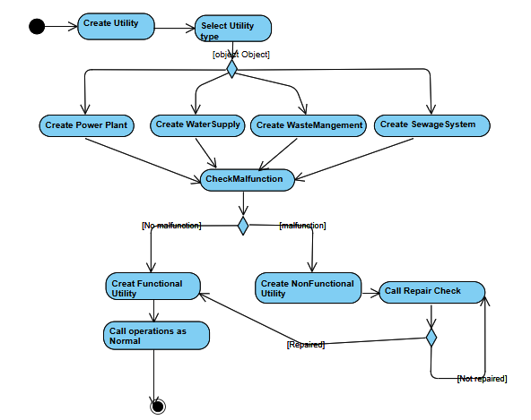
Utilities Activity Diagram

Slide 17

Transportation
Roads: Basic infrastructure for public transport movement.
Public Transit: Buses to transport citizens to and from place of employment.
Commercial busses transport citizens of type Commercial Worker to/from their Residence: House to/from Workplace: shop/mall/office on a Commercial road
Government busses transport citizens of type Government Workers to/from their Residence: Mansion to/from Workplace: school/hospital/government on a Government road
Industrial busses transport citizens of type Industrial Workers to/from Residence: Apartment to/from Workplace: warehouse/plant/factory on an Industrial road
Trains: Transport materials on railways

Slide 18
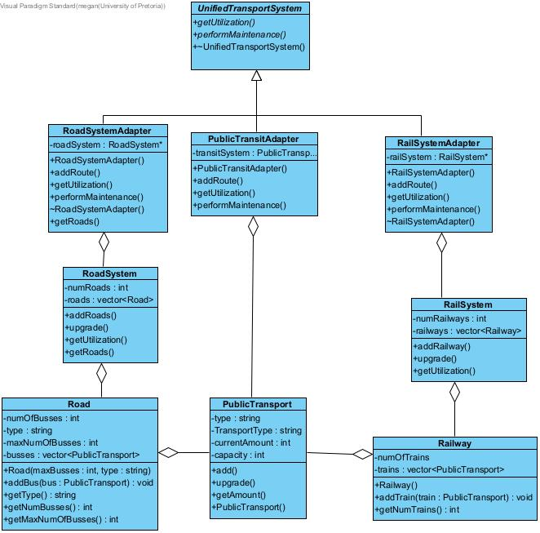
Uses Adapter design Pattern
Adaptees: Have specific requests
PublicTransport, RoadSystem and RailSystem
Adapters: Call each corresponding adaptee’s specific request.
PublicTransitAdapter : adapts current transport by increasing capacity, when adding passengers/materials will exceed current capacity.
RoadSystemAdapter : adapts current road system by using utilization to calculate what the number of busses is compared to maximum amount of busses allowed on a road, if ration becomes too large a road is added in upgrade
RailSystemAdapter : adapts current railway system by using utilization to determine the amount of trains per railway and adds railways in update when the ratio becomes too large
Target: UnifiedTransportSystem
Transportation

Slide 19
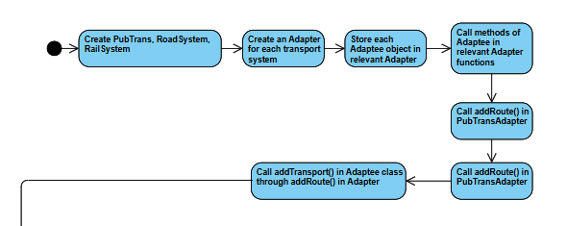
Transportation Activity Diagram

Slide 20
Routines:
Commands that the Government call:
Design Pattern: Implements the Command design pattern. Allowing for the government(user) to call the same method on several objects through one function call.
Each concrete command stores a vector of their relevant adapter objects. The transport adapters call their performMaintenance() methods when the commands call their execute() methods. This allows for all the transport to be updated through on method call.
Each concrete command is stored in a vector of GovernmentCommands within the MonthlyRoutines class. This allows for the government to call all Transport or all building related commands at once.
The Government keeps a reference to a MonthlyRoutines object which is used to call the commands.
The main commands used are the Transport related commands as there may be insufficient transport for the citizens, which the government can address calling the Upgrade Transport actions to restore the citizens satisfaction.

Slide 21
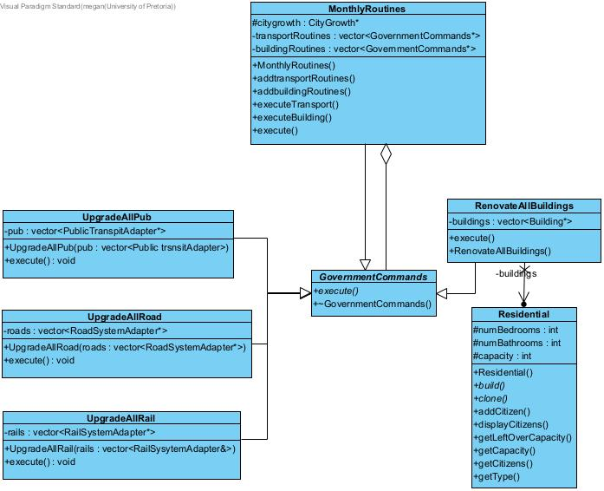
Routines:
Command Pattern
Command :
GovernmentCommands.
ConcreteCommands
UpgradeAllRoad
UpgradeAllPub
UpgradeAllRail
RenovateAllBuildings.
Invoker
MonthlyRoutines
Client
Government
Receiver
RoadSystemAdapter
RailSystemAdapter
PubTransportAdapter
Buildings.

Slide 22
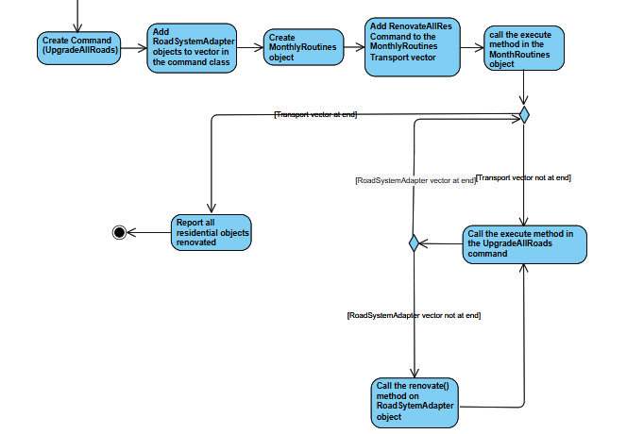
Routines Activity Diagram

Slide 23
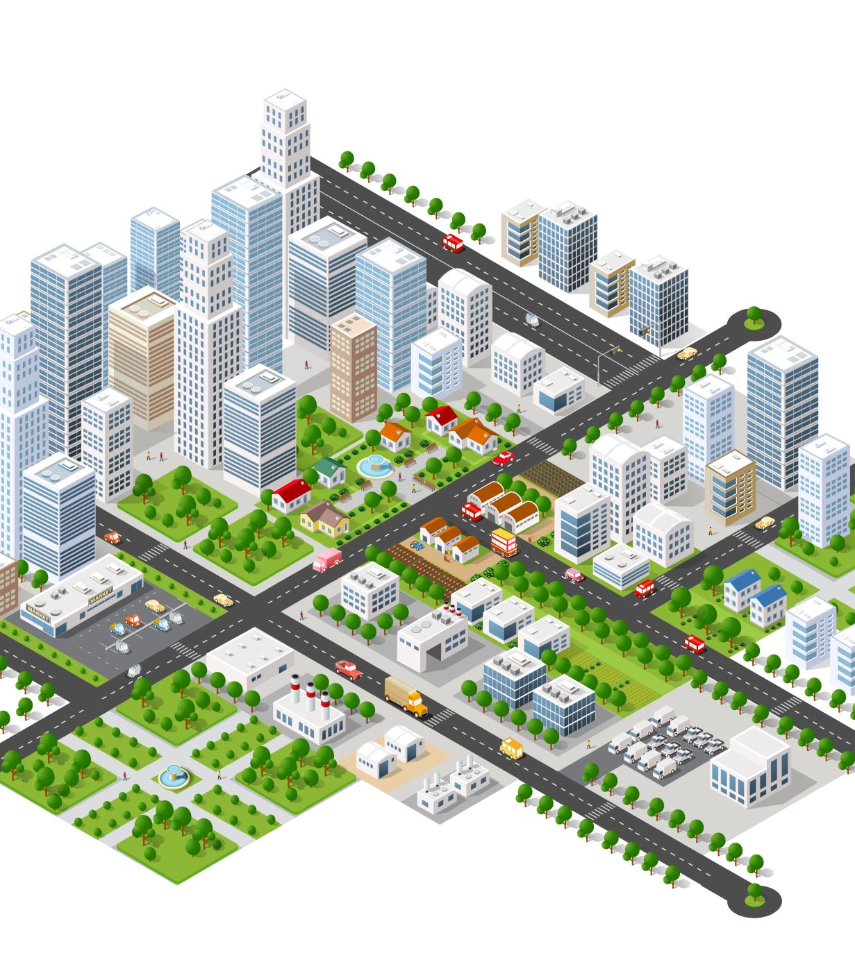
City Growth:
Pattern used: Composite pattern
The CityGrowth class inherits from the CitySector class and serves as an overview of the city, such as the different CitySectors and all the types of Buildings in those Sectors as well as Citizens in the Buildings.
CityGrowth contains a vector of all the Sectors in the City.
CitySector contains a vector of all the Buildings in the Sector.
Certain buildings might contain a vector of all the Citizens in the Building.

Slide 24
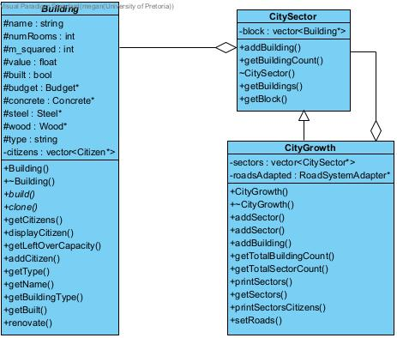
City Growth:
Composite pattern:
Component: CitySector
Composite: CityGrowth
Leaf: Buildings
Leaf and Composite inherit from Component, and Composite may contain multiple children that are Components

Slide 25
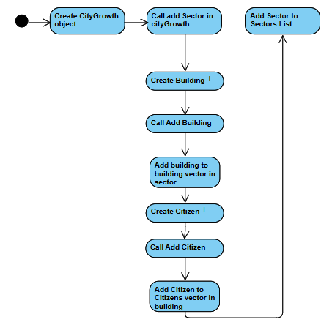
City Growth Activity Diagram

Slide 26

Taxes
TaxSystem
Pattern used: Strategy pattern
The TaxSystem has different taxStrategy options to use when taxing Citizens.
The TaxSystem uses CityGrowth to find all taxable Citizens and calculates the tax amount using the desired strategy FlatTaxStrategy will calculate taxes based on the Citizens occupations.
ProgressiveTaxStrategy will calculate taxes based on the Citizens occupations, but this amount will increase depending on the number of Citizens in the City.
Taxes are collected once every 8 moves in the game.

Slide 27
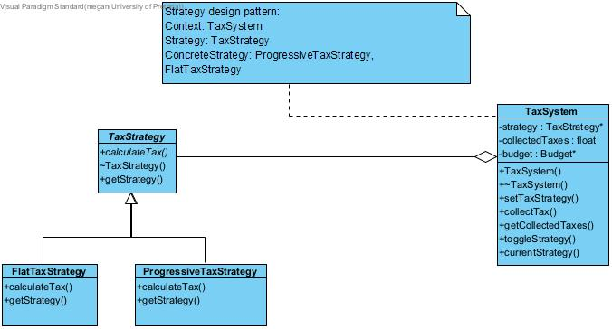
Taxes
Strategy pattern:
Strategy: TaxStrategy
ConcreteStrategyA: FlatTaxStrategy
ConcreteStrategyB: ProgressiveTaxStrategy
Context: TaxSystem
TaxSystem holds an instance of the current selected TaxStrategy.
The Government holds an instance of the TaxSystem and can decide what Strategy to use when Taxing the City.

Slide 28
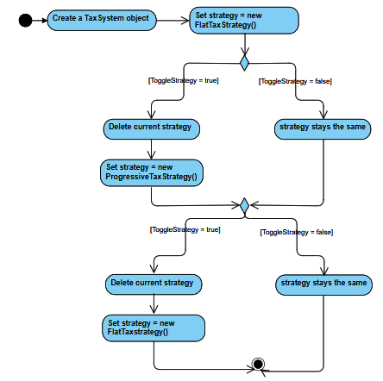
Taxes Activity Diagram

Slide 29

Resources:
All the resources implement the singleton design pattern. This ensures each resource has only one instance. A city can only have one of each resource.
Resources are used throughout the city to build, upgrade and maintain infrastructure.
The abstract Materials class and its respective base classes implement the template method. The increase() method in Materials calls the abstract functions obtain() and refine(), since different materials are increased differently.

Slide 30
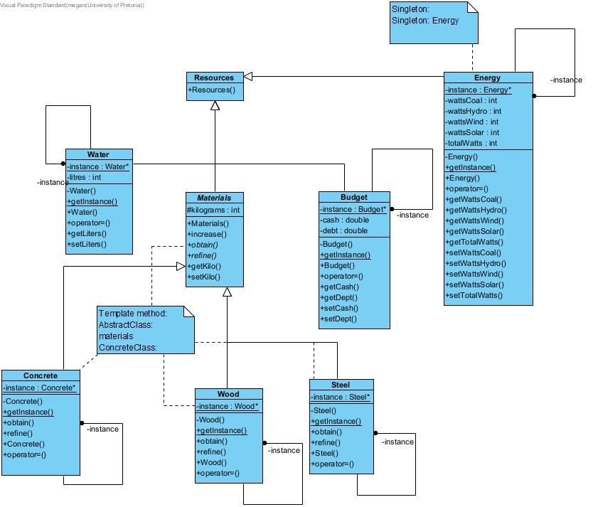
Resources:
Design patterns
Singleton :
Singletons: Energy, Budget, Water, Steel, Wood, Concrete
::getInstance() returns the instance of the singleton
Template Method:
AbstractClass: Material
ConcreteClasses: Wood, Steel, Concrete

Slide 31
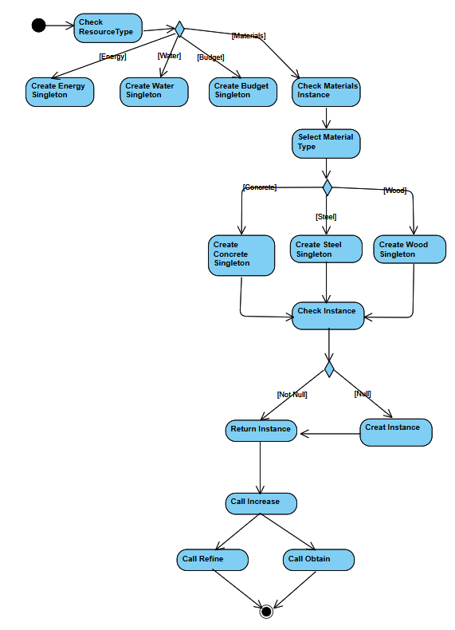
Resources Activity diagram

Slide 32

Government
The government class participates in most of the design patterns as the context/client.
Government acts as the subject in the observer design pattern and notifies citizens of changes.
The government class provides actions for the user to perform to interact with the city
Government will be expanded on in the live demo

Slide 33
Doxygen
https://cos214-project-2024.github.io/sudo-apt-get-marks/html/index.html

